Slide 1
Electricity
Aerospace Manufacturing Core Study Guide
“AMCSG-204”
Tools & Processes

Slide 2
Electricity

Slide 3
Level Set
Text from Google AI
Electricity = essential part of airplane
Airplanes use electricity for flight controls, safety equipment, cabin amenities, avionics, hydraulic pumps, lighting, etc.
Airplanes use 40+ miles of wiring to move electricity where it is needed
Bonding and Grounding control flow of all electricity (wanted power and unwanted static)

Slide 4
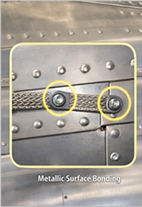
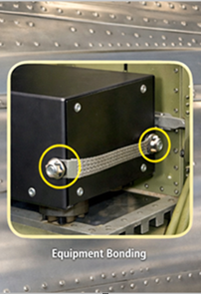
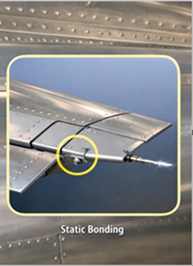
Electrical Bonding
Text from ChatGPT
Electrical Bonding = connecting all non-power carrying metallic objects in the airplane and airframe
Three Types:
Metallic Surface Bonding
Equipment Bonding
Static Bonding
ChatGPT / Matt Pierce, 2026
Notes:
Metallic Surface bonding = Assemble metal-to-metal so electricity can flow out
Equipment bonding = Attach equipment to metal airframe of body to prevent static electricity building / interfere radio and nav equip
Static bonding = Attach isolated parts to the rest of the metallic bond
Three Types Bonding Pic: ChatGPT: “make a picture of three type of bonding in an airplane: metallic surface bonding, equipment bonding, and static bonding” + “Combine these into one single composite image with three sections. Tune it specifically for maintenance training. Make examples in aluminum.” + “Making it one continuous fuselage scene with three highlighted zones” + “Adding subtle cues for inspection points (fasteners, straps, contact areas)“

Slide 5
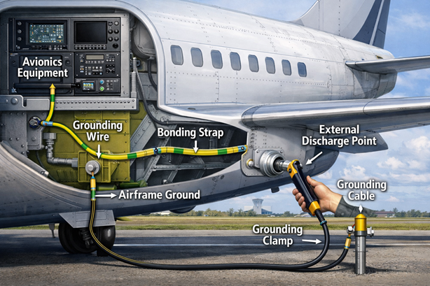
Electrical Grounding
Text from ChatGPT
Electrical Grounding = redirecting power spikes to airframe, then out external discharge points to atmosphere
Grounding Prevents…
Arcs thru air between electrodes
Static Electricity; safe discharge
Coupling between circuits
EMP (only Faraday cage withstands)
ChatGPT / Matt Pierce, 2026
Notes:
Grounding Pic: ChatGPT: “make a single picture of electrical grounding in airplane from a circuit to airframe then out external discharge point.“

Slide 6
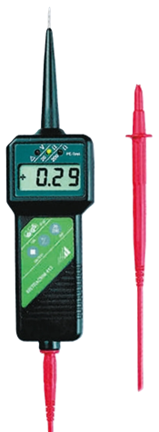
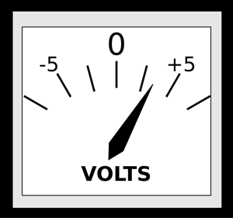
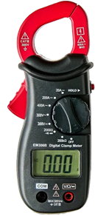
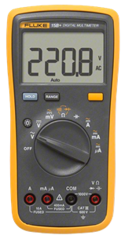
Electrical Testing Equipment
Voltmeter
Electricity can be measured as
Volts (pressure)
Amps (flow rate)
Ohms (resistance/pipe size)
V = I x R
1volt = 1amp x 1ohm
There is a meter for each, or all in one:
Voltmeter
Ohmmeter
Ammeter
Multimeter
Ohmmeter
(Ad) RS Products, 2026
(PD) FreeSVG.org, 2017
Multimeter
Ammeter
(Ad) Grainger, 2026
(Ad) Walmart, 2026
Notes:
Image Credits:
Voltmeter: Google = (PD) - https://freesvg.org/analog-gauge
Ohmmeter: RS Products = (Ad) - https://africa.rsdelivers.com/product/gossen-metrawatt/m630a/gossen-metrawatt-ohmmeter-10-m%CF%89/4375932
Ammeter: Google = (Ad) - https://www.walmart.com/ip/Hyper-Tough-New-Digital-Clamp-Meter-TD35074B-6-4-oz-1-Count-1-25-in/410005314?wl13=2317&selectedSellerId=0&wmlspartner=wlpa
Multimeter: For Sale / Public – https://static.grainger.com/rp/s/is/image/Grainger/F-15b-plus-01c__FHFE_v2?$adapimg$&hei=804&wid=804

Slide 7
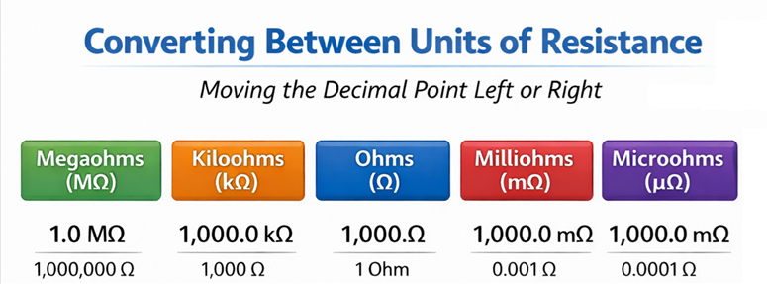
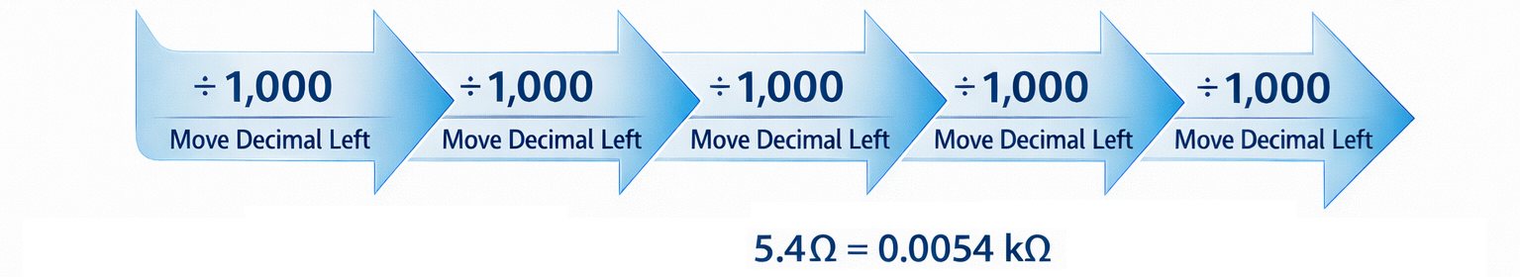
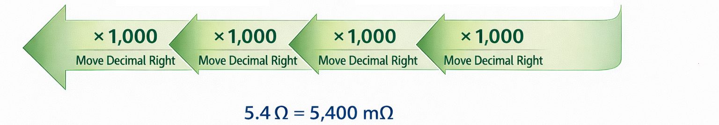
Example #1
Example #2
ChatGPT / Matt Pierce, 2026
Notes:
Image Credits:
ChatGPT - make a diagram explaining how the decimals move left or right for megaohms to kiloohms to ohms to milliohms to microohms + Change the "+ 1,000" labels all to "÷ 1,000“ + Add an example below the blue arrows (but above the green arrows) demonstrating how 5.4 ohms = 0.0054 kiloohms Add an example below the green arrows demonstrating how 5.4 ohms = 5,400 milliohms

Slide 8
Q&A

Slide 9
Practice Q&A’s (Q1-Q8)
Q5: What four dangers does electrical grounding prevent?
A: 1. Arcs, 2. Static Electricity, 3. Coupling (between circuits), and 4. EMP
Q6: What is the formula representing the relationship between voltage, current, and resistance?
A: V = I x R; Voltage = Current x Resistance; 1 volt = 1 amp x 1 ohm
Q7: What is the measure of current?
A: Amperes
Q8: What is the measure of resistance?
A: Ohms
Q1: What is essential to an airplane for flight controls, pumps, equipment, lighting, etc.?
A: Electricity
Q2: Name of design that connects all non-power carrying metallic objects in an airplane to the airframe?
A: Bonding
Q3: Name of design that redirects spikes in power carrying equipment and lines to the airframe?
A: Grounding
Q4: How does electrical bonding work?
A: Wire straps connect to provide circuit between different metal surfaces, isolated metallic equipment, etc.

Slide 10
Practice Q&A’s (Q9-Q10)
Q9: What is the measure of voltage?
A: Volts
Q10: What are the six size buckets for Ohms from left (largest) to right (smallest)?
A: Mega-ohms, Kilo-ohms, Ohms, Milli-ohms, Micro-ohms
Divide by 1,000 to shift right 1 (smaller units)
Multiple by 1,000 to shift left 1 (larger units)

Slide 11
Thank You
Matt Pierce - mpierce710006@gmail.com - linkedin.com/in/mpiercead576/
https://github.com/DataResearchLabs/study_guide_intro_aerospace_mfg

